Slide 1

Robot Software Engineering Presentation
GroupF4
机器人软件工程学期末展示
小组成员：
张明昕1611260 邓壬鑫1611410
冯宇康1611412 张岩1611466
June, 2019

Slide 2

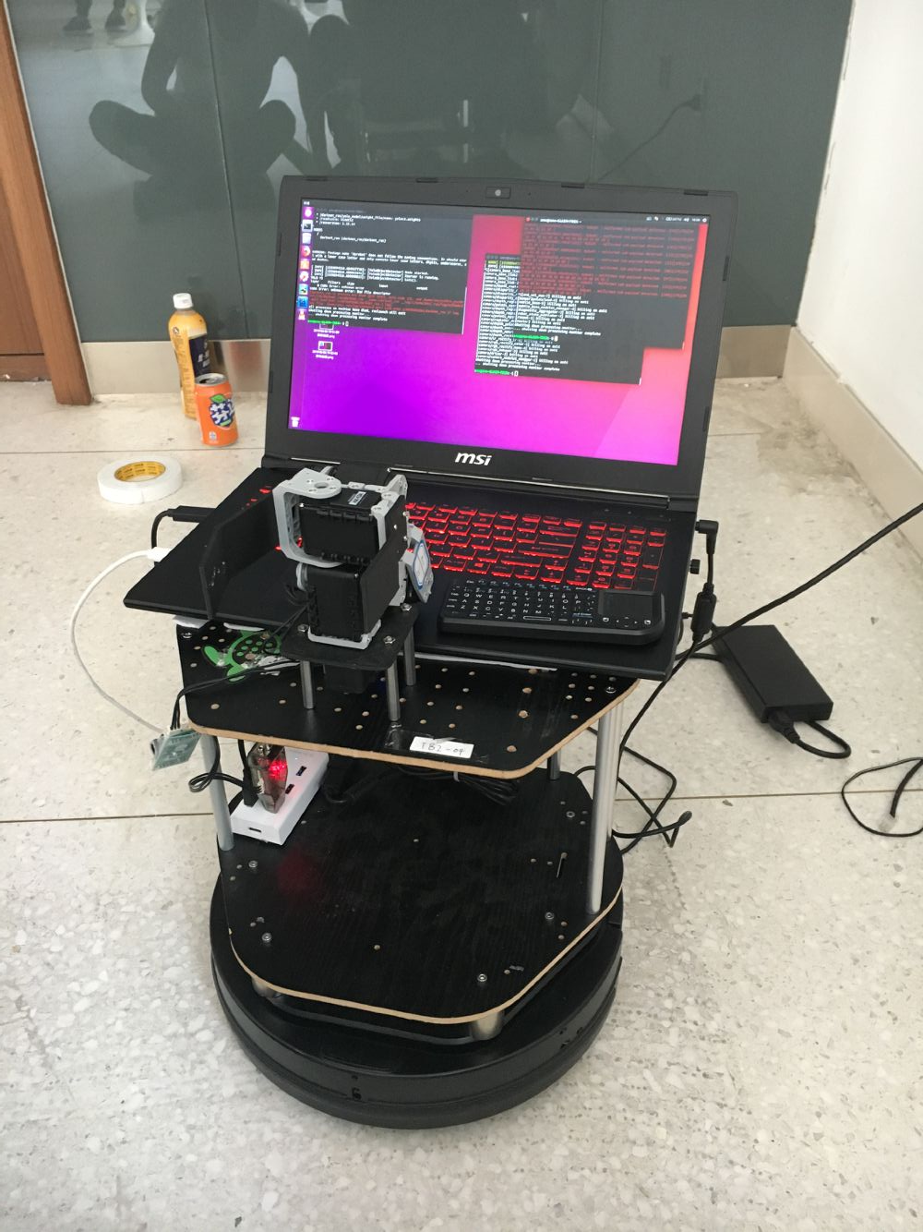
Introduction
ABOUT RESTAURANT
Goal 1: Detect a customer's service request
Goal 2: Reach a customer's table without prior guidance
Goal 3: Grab objects
Goal 4: Transport an order

Slide 3
Team Work
张明昕 ： Navigation , Recognation of Body Pose ,Find People
邓壬鑫 ： Face Recognition
冯宇康 ： Voice Interaction
张岩 : Arm Control and Object Catching

Slide 4
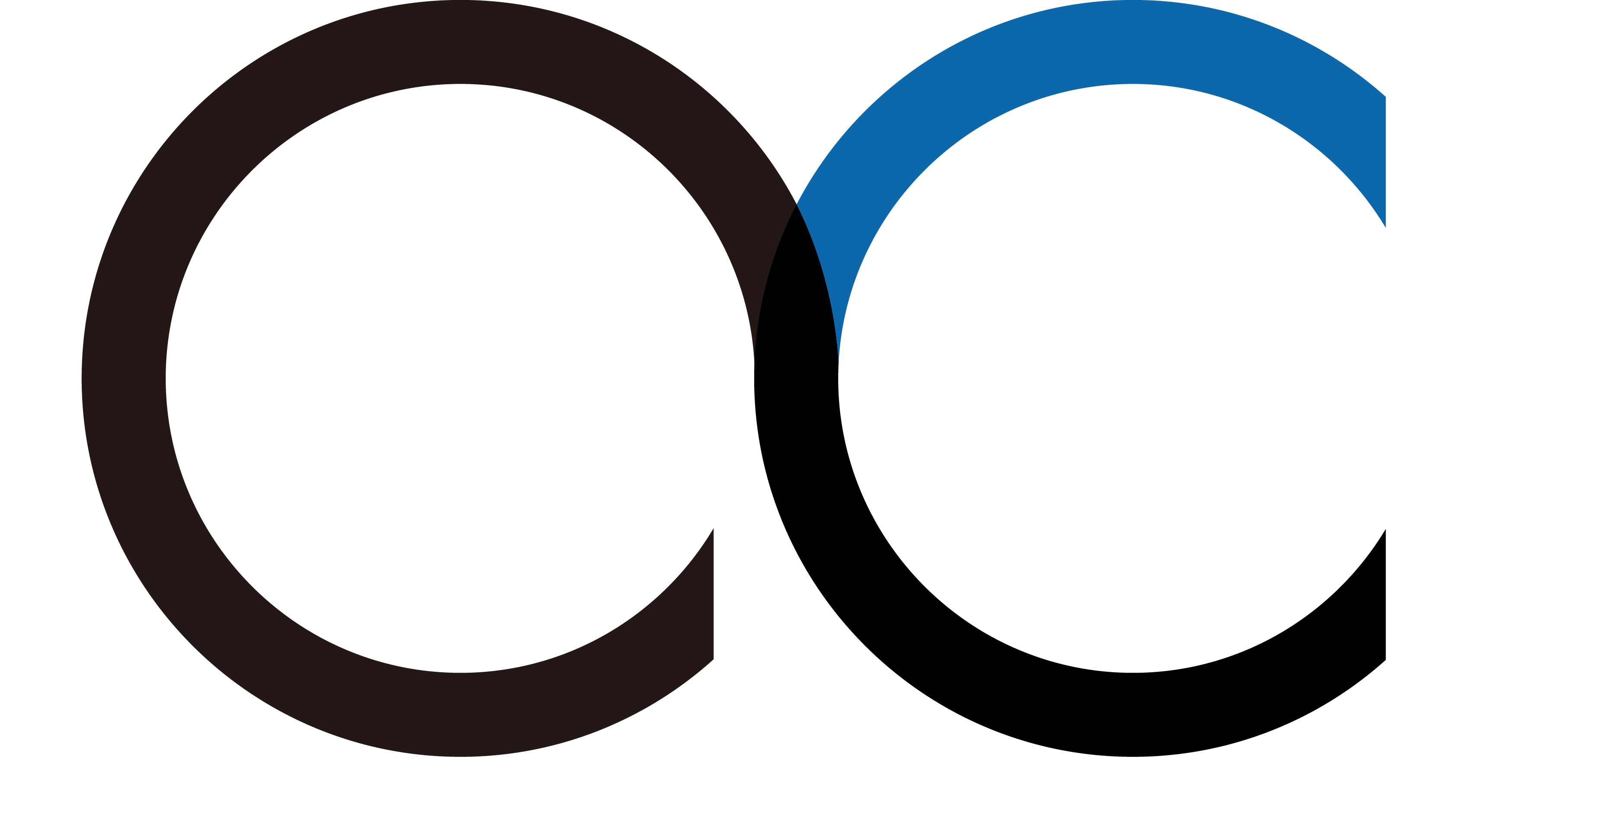
Navigation
Base on rchomeedu_navigation navigation.py
- Navigation between two fixed locations
Receive one of the location information from node find_people (the location of customer)
The second location is the goal
Wait for some messages during navigation to make sure the order of the process is correct

Slide 5
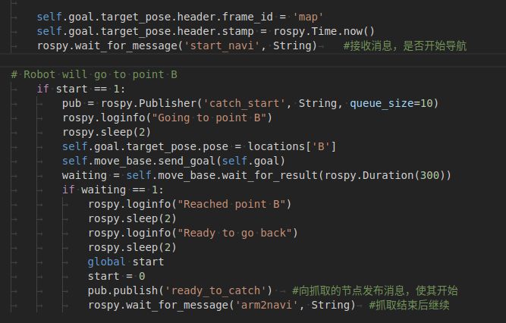
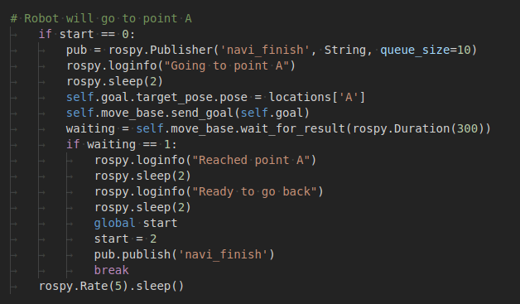
Navigation

Slide 6
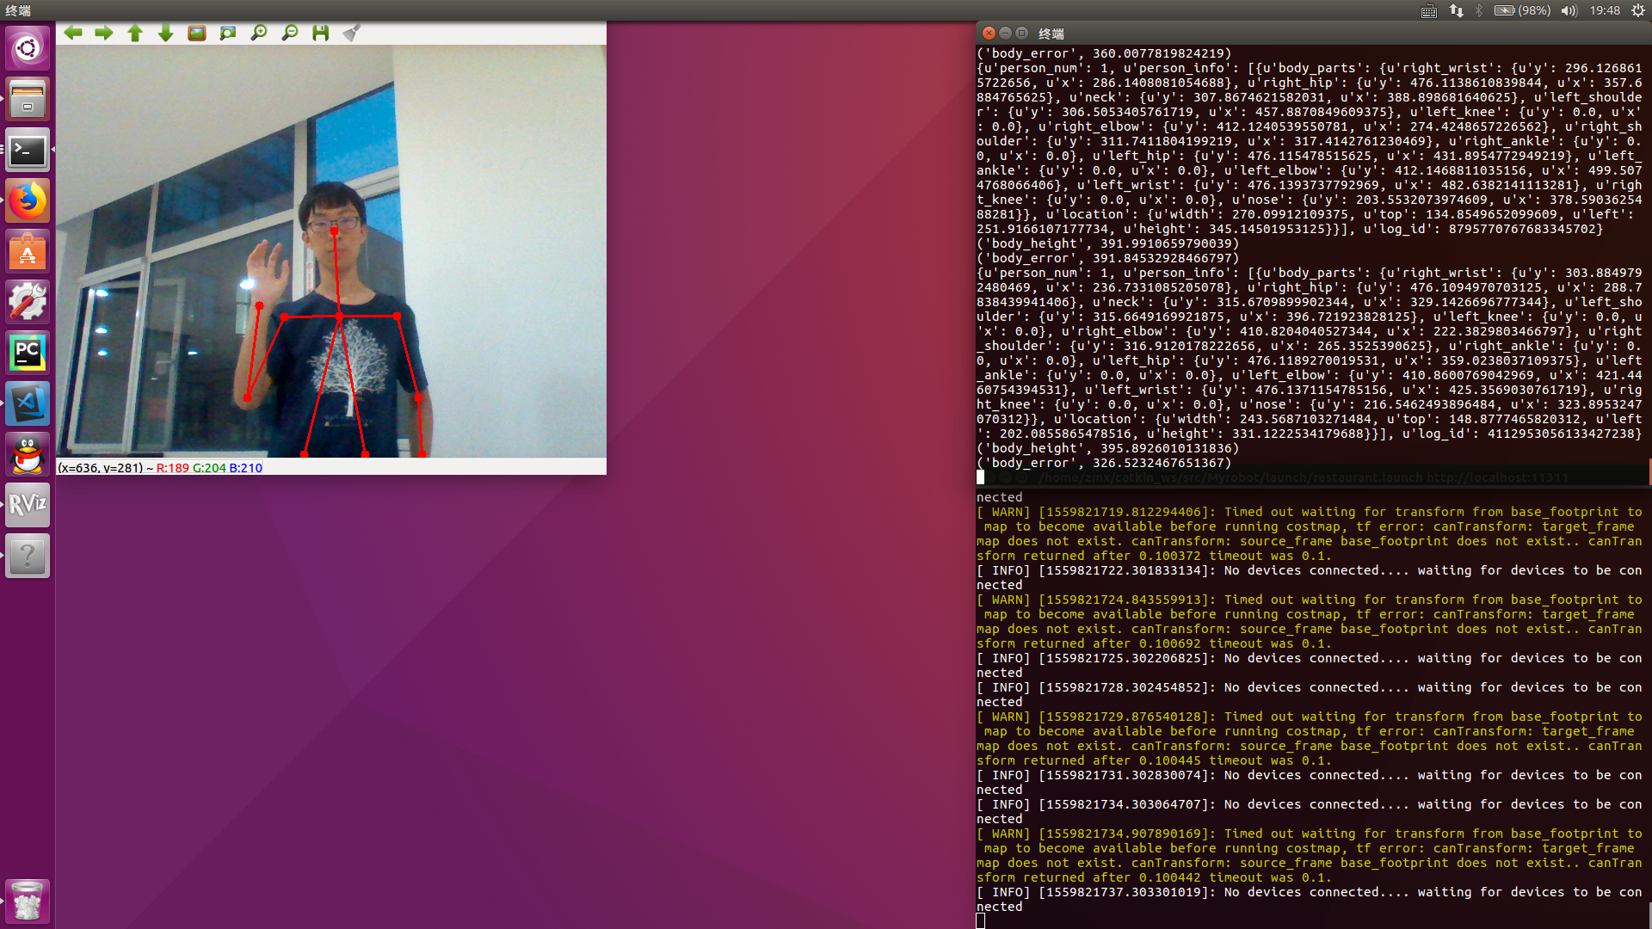
Recognation of Body Pose
Base on OpenCV and Baidu API

Slide 7
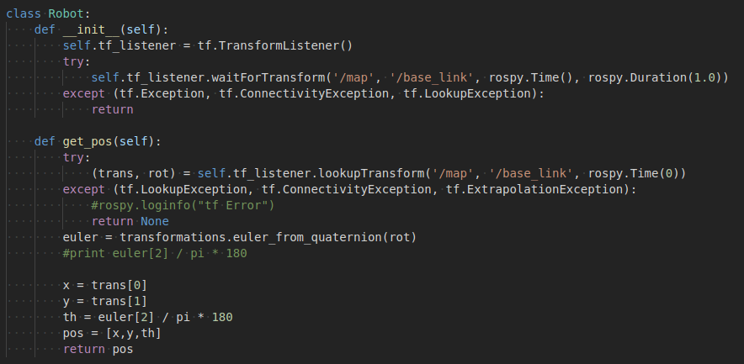
Find People

Slide 8
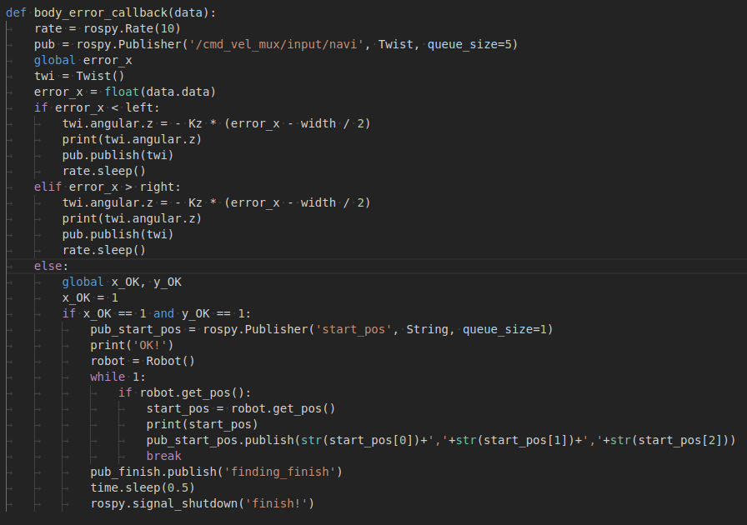
Find People

Slide 9
Face Recognition Based on Sexuality
As for the realization of restaurant theme, our team members have realized its basic functions, but for our bartender robot, I think we need to add some additional small functions to improve the practicability and quality of service of the turtlebot robot.
Our team members used object recognition technology in the process of picking up objects by robots. I want to continue to use face recognition technology to specify the gender of men and women so as to determine whether to stop action after picking up wine cups (the default recognition is that men do not stop, women do not stop) in order to improve the quality of service.

Slide 10
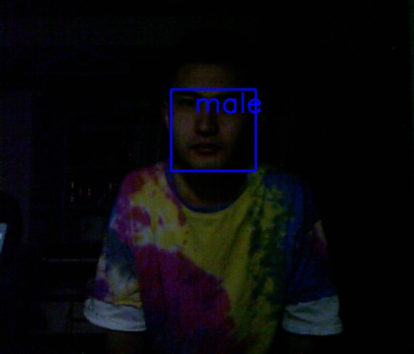
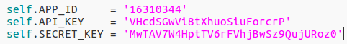
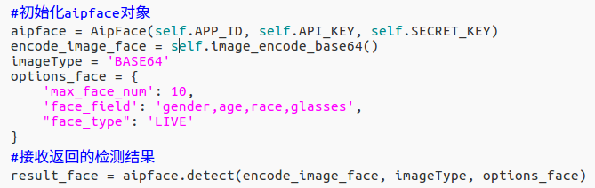
Specific Realization of Gender Recognition

Slide 11
Problems
In the process of facial recognition, we sometimes find some reasons inside and outside the camera. The generated object image often distorts. In order to avoid the error caused by the data source, we need to calibrate the parameters of the camera.

Slide 12
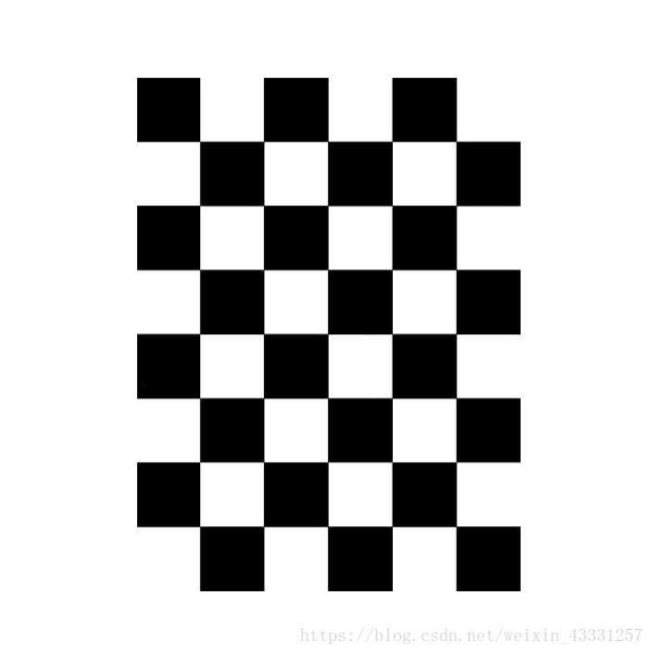
Camera Calibration
要求： 相机的左侧，右侧，顶部和底部的棋盘格 X栏 - 在视野中左/右 Y栏 - 视野中的顶部/底部 尺寸栏 - 朝向/离开并从相机倾斜 棋盘填满整个视野 棋盘向左，向右，向上和向下倾斜（歪斜） 在每个步骤中，保持棋盘静止，直到图像在校准窗口中突出显示。

Slide 13
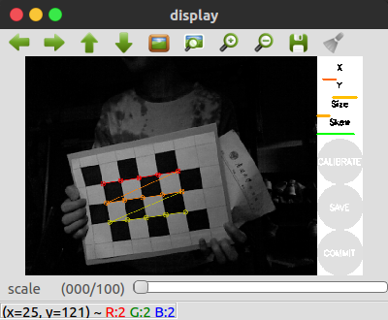
Camera Calibration
1.终端：roslaunch freenect_launch freenect.launch
2.开一个新终端:rosrun camera_calibration cameracalibrator.py image:=/camera/rgb/image_raw camera:=/camera/rgb --size 3x5 --square 0.016
When moving the chessboard, you will see an increase in the length of the three bars on the calibration sidebar. When the CALIBRATE button is on, there is enough data to calibrate, and click CALIBRATE to see the results. Calibration takes about a minute. The window may be grey. It's working. 4. Result Processing Click save, will card for a while. Click upload. Data will be imported automatically. Restart Camera Calibration Completed 。

Slide 14
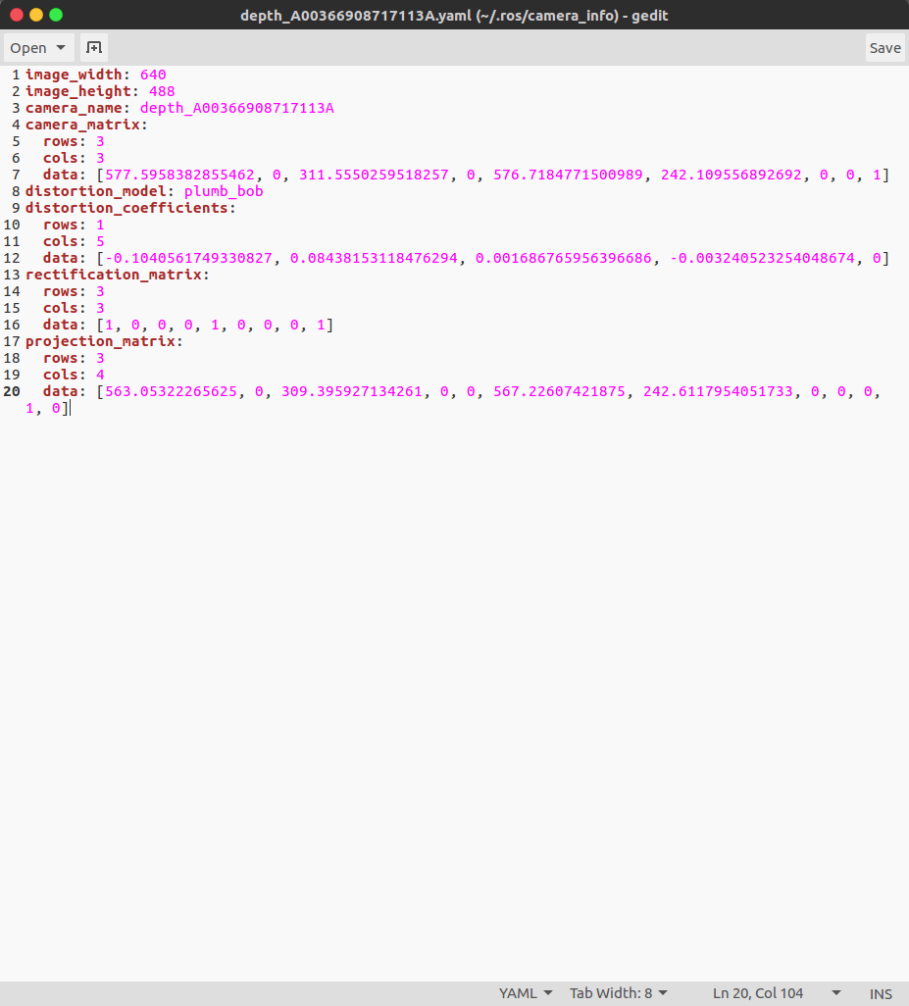
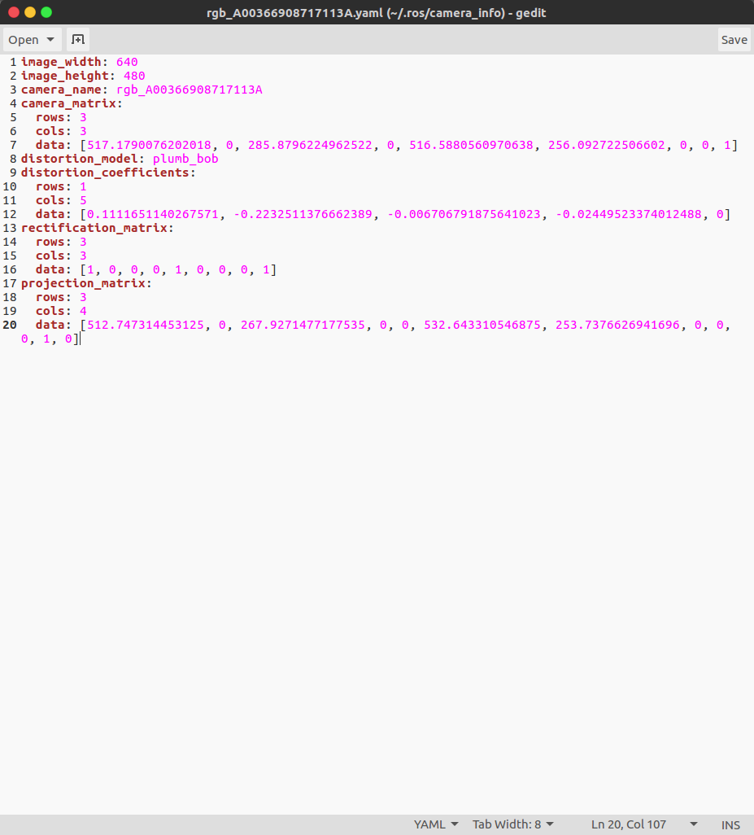
Camera Calibration
Result:

Slide 15
Voice Interaction
Define a talk function in main.py:
def talk(text):
pub = rospy.Publisher('speech', String, queue_size=10)
time.sleep(0.1)
pub.publish(text)
Section1：When the robot recognizes the customer's beckoning action, he would say “Yes, I'm coming.”
Section2：When it receives the message of “finding_finish”, he would say “Hello! What would you like to have? Coffee or tea?".Then it would excute "iat_publish_speak" and then Then the string "coffee" or "tea".
Section3:When it receives the message of “navi_finish”,he would say "Here is your' + drink + '. Enjoy yourself"

Slide 16
Arm Control
Restrain System Error：
Ⅰ. By restraining the error of navigation
Ⅱ. By restraining the error of the arm
Answer : The first one is better!
Solutions to solve the problem
Objects Recognition Using Darknet_ros and Kinect:
1. The Kinect image information is used to frame the identified object, and the average depth of all points of the object is calculated as the distance value.
2.The angular velocity and linear velocity of the chassis are adjusted respectively to make the distance error reach a certain threshold.
Then

Slide 17
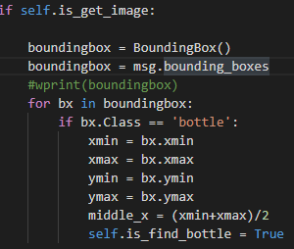
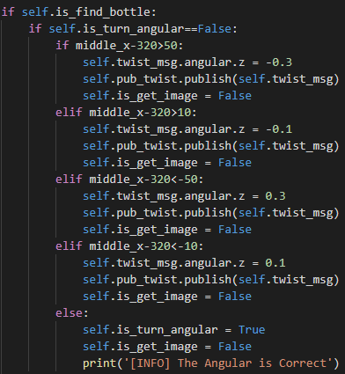
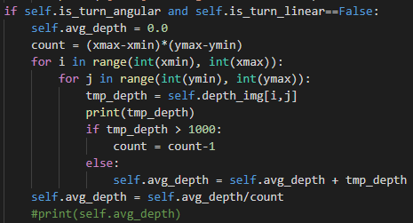
frame the identified object
The adjustment of angular velocity and linear velocity
average depth of all points of the object

Slide 18
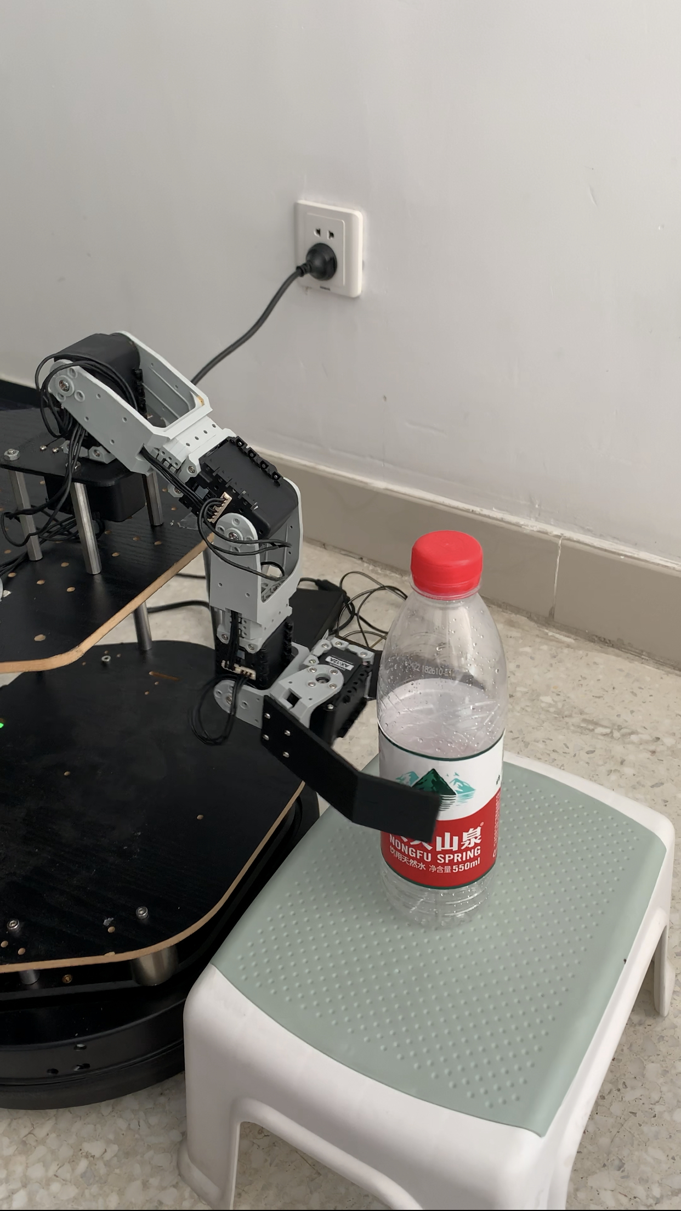
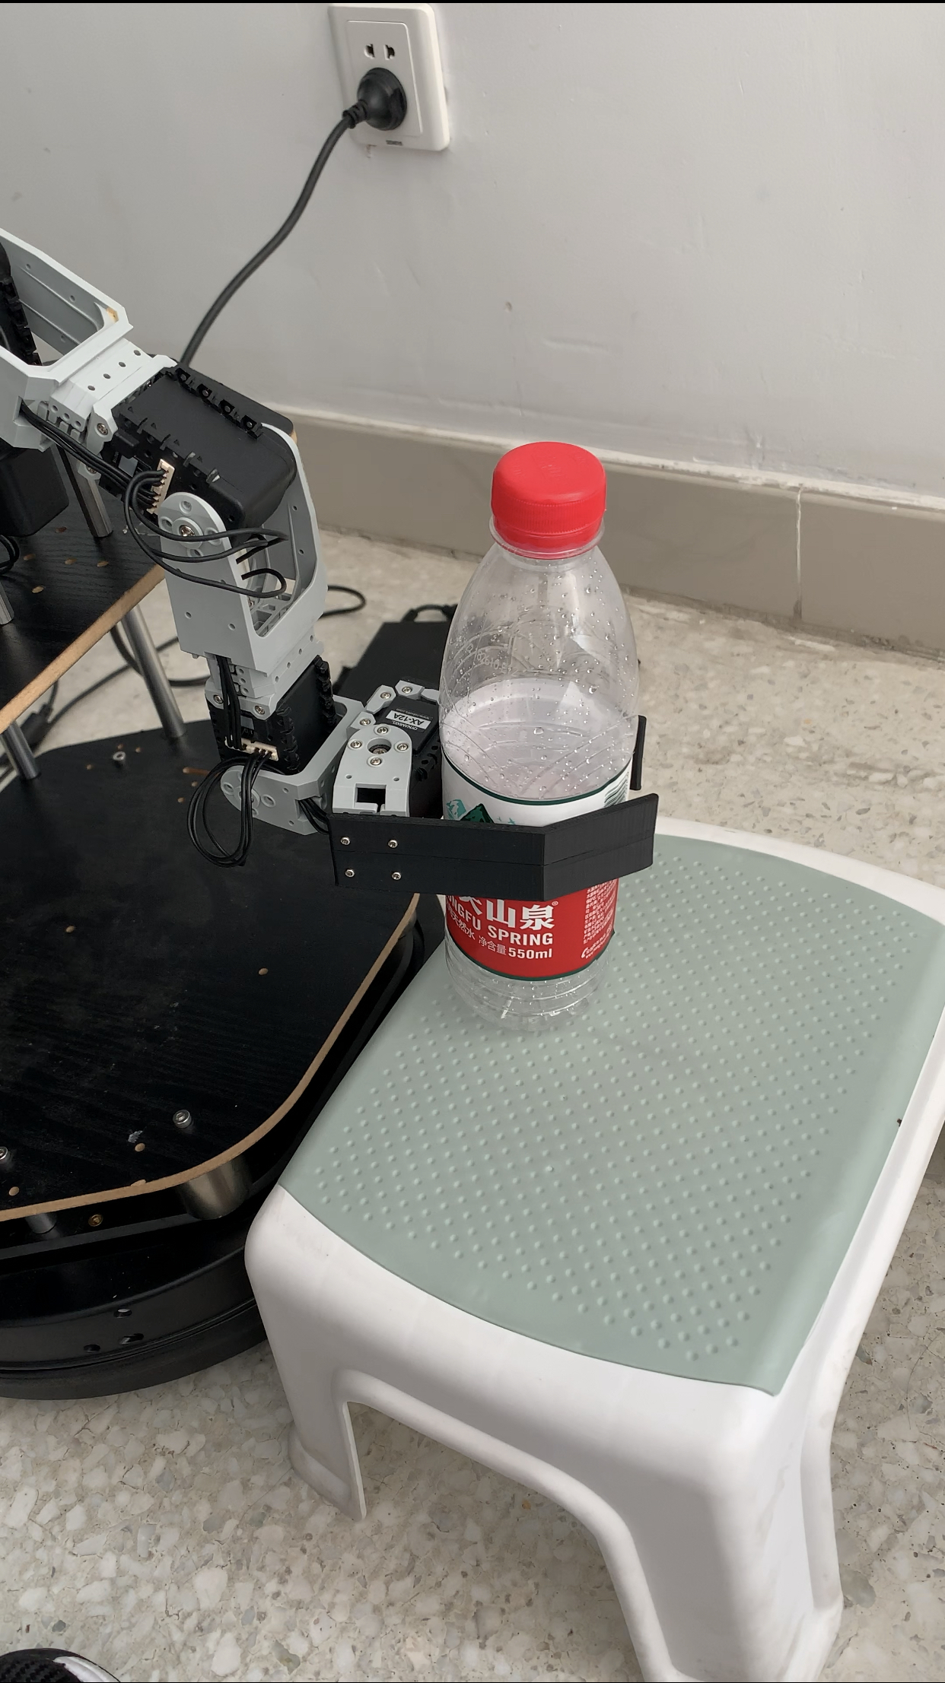
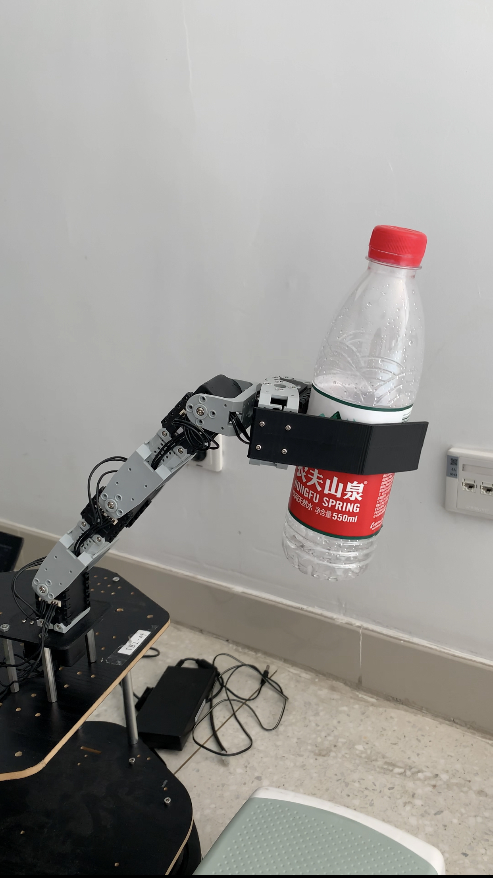
Catching
After reaching the exact position, the arm can grasp the object according to the specific postures.

Slide 19
Summery
Improvable aspects:
1.Due to the use of BaiduAPI, there is a long delay leading to pauses.
Ans:
Use BaiduAPI only when recognizing gestures, Darknet and kenict can be used for tracking.
2.Robot positioning is inaccurate.
Ans:
Improve amcl.
3.Low success rate of grasping objects.
Ans：
We have no idea.

Slide 20
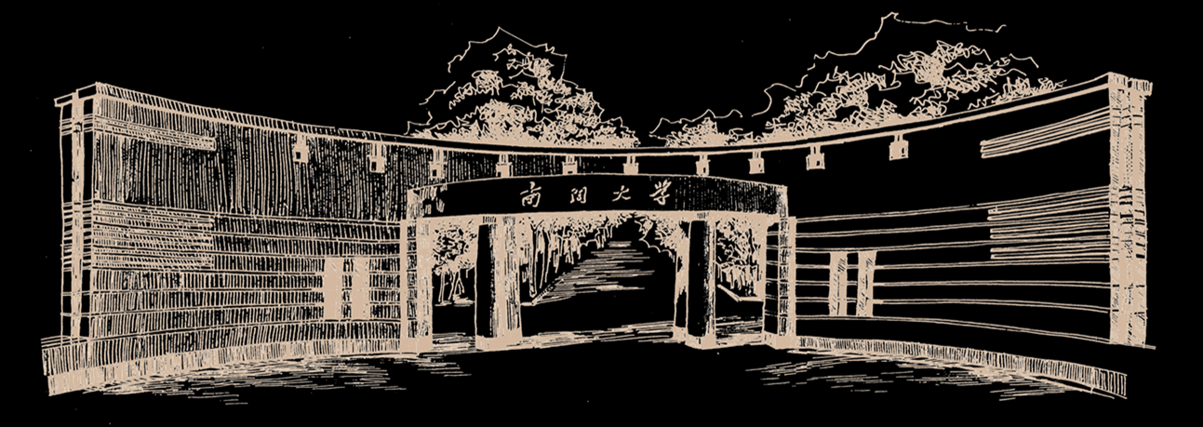
Thanks！

